Slide 1

Sprint 3 Delivery

Slide 2

Table of contents
1: Current sprint
2: Documentation
3: Network drawing
4: WAF
5: Demo
6: Future sprint

Slide 3
Current sprint
Added improvements based on feedback from last sprint
Web Application Firewall
Proof of concept network
Actual Implementation from design

Slide 4

Documentation
Reupdated Network VLAN to /29
NIST CIA table Adjusted High/medium/Low explaination

Slide 5
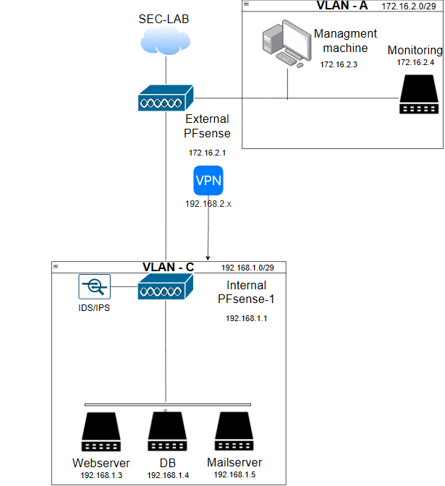
Network drawing
Previously communicated with the client regarding a VLAN-B which wasn’t needed according to the client
They attack the database from the webserver

Slide 6

Web Application Firewall
changed:
SecAuditLogParts & SecDebugLogLevel
SecAuditLog
ToDo:
Automatic CRS update script

Slide 7

Demo

Slide 8

Future sprint
Test/Deployed proof of concept honeypot
Added improvements based on feedback from last sprint

